Slide 1
Introduction to NCEA
For Year 11

Slide 2
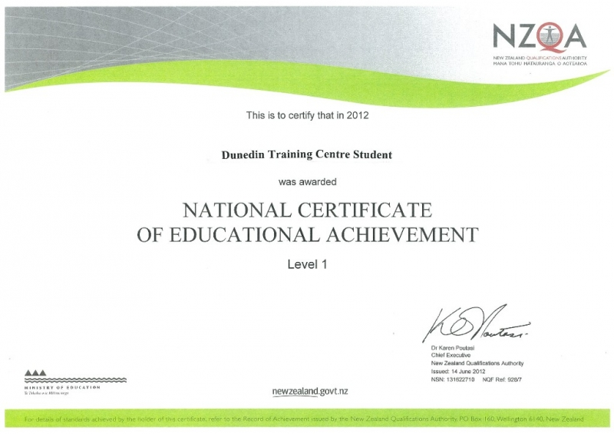
NCEA Stands For -
National Certificate of Educational Achievement
Comes at three levels
NCEA Level 1
NCEA Level 2
NCEA Level 3
Students study for these in years 11 - 13

Slide 3
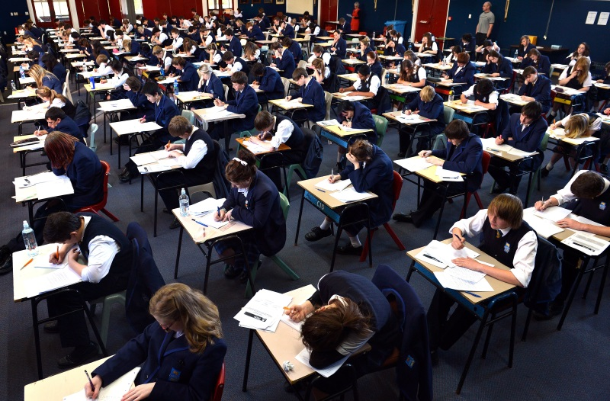
For NCEA we get assessed in two ways -
External Assessment – this is the external exams at the end of the year, MCAT, Portfolios – Visual Art, Technology. There is the option
of sitting some exams digitally.
Internal Assessment – this can be tests, laboratory assessments, practical assessments run by our teachers during the year
For this our subjects are divided up into all the things you need to know called –
Standards – Achievement standards and unit standards
Achievement Standards – Internal or external – A, M, E
Unit Standards – Internal only – pass or fail

Slide 4
All standards are worth credits
To get NCEA Level 1 I need to get –
60 Credits at level 1 or above.
And
Literacy – 10 Credits which can come from the new corequisite exams (writing and reading standards) or for 2024/25 transition years a variety of subjects and show your ability to write, speak and listen.
And
Numeracy – 10 Credits from the Numeracy Corequisite exam or for 2024/25 transition years a variety of subjects and show your ability in number, measurement, and statistical skills.

Slide 5
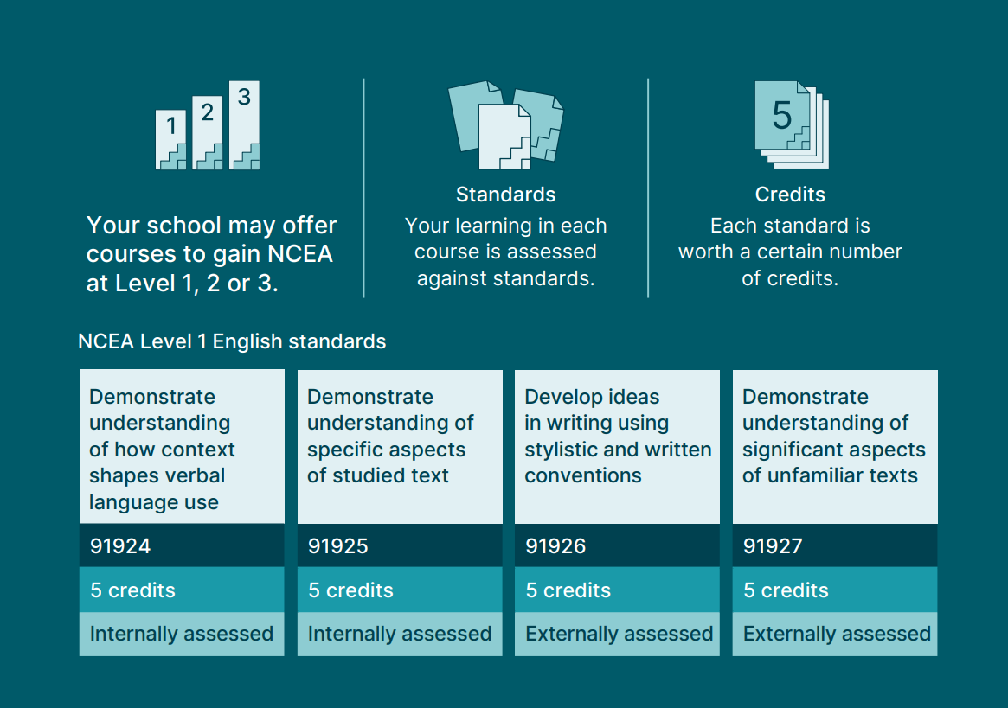
Course Structure

Slide 7
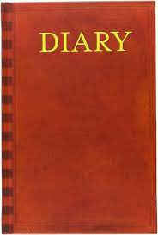
To keep track of your credits as they build you can -
Look at your school reports
Use the tracking sheets given to you by your teachers
Record them in a diary
Log into KAMAR Portal
Log on to NZQA with personal ID and password.

Slide 8
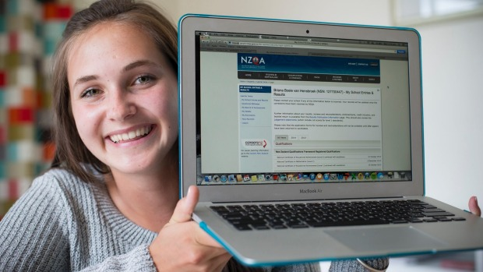
Logging on to NZQA
In a month or so you will be issued with a wallet card that will help you to log onto NZQA and monitor your own progress. Each standard result will have N A M E beside it standing for-
N Not achieved
A Achieved
M Achieved with merit
E Achieved with excellence

Slide 9
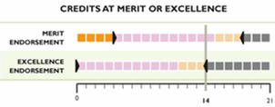
Why do you need excellence credits?
If you get 50 at excellence or merit you will get your NCEA Level 1 Certificate endorsed. This shows how good you are
It shows what subjects you are strong in.
Subject Endorsement – if you get 14 or more credits at excellence or merit (in a single year) you will get that subject endorsed. You need at least 3 credits from an external assessment to achieve this in most subjects.
Employers will use this to compare you to other applicants for jobs.

Slide 10
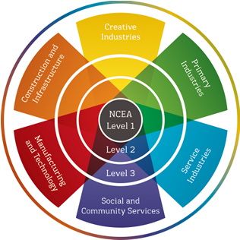
Vocational Pathways
You can gain credits in six different types or pathways from many of your subjects. If you accumulate enough in one pathway you will get a Vocational Pathways Award.
This can show employers particular strengths you have
The pathways are:
Construction and Infrastructure
Manufacture and Technology
Primary Industries
Service Industries
Social and Community Services.
Creative Industries

Slide 11
Having an idea of where you want to go.
Why is this important?
You want to know the subjects you are studying are taking you in the right direction
Its not just about getting lots of credits. You need to think about what subjects you are getting them in.
You can get help with this from Mrs Duncan our vocational guidance specialist here at school. You will have subject selection and coursing interviews.

Slide 12
Academic Assistants Discussion
Importance of being organised
Using Tutorials
Preparing for exams
Using your time wisely
Keep track of your credits – KAMAR Portal Demonstration
How to study
Other

Slide 13
Part 2 – Important Rules and Procedures

Slide 14
Pre-requisites of year 12 and 13 courses.
You do not have automatic right of entry to year 12 and 13 courses.
Most of these courses have pre-requisites.
These are laid out in the Senior Subject Selection information on School Point for you to check.
Don’t be disappointed. External Exams are very important for this reason.

Slide 15
Signing off your work.
When you receive an internal assessment back from your teacher you must sign off the grade.
This will then be entered in the school’s management system and forwarded to NZQA

Slide 16
Appeals
Students can appeal a grade awarded.
This must be done within five days.
The process is outlined in the student handbook.

Slide 17
Reassessment (Further Assessment Opportunities)
This will be offered for internally assessed achievement standards where it is practicable to do so.
It can be used to help a student who has just missed the standard.
It can be used to enhance a students grade.
There will be only one reassessment opportunity per standard where it is practicable to do so.

Slide 18
Forms Of Reassessment
A whole new task or test.
Another written question on the part missed.
A verbal reassessment with a teacher.
Redoing a practical task.

Slide 19
Timing of the year.
Term 1 – 11 weeks
Term 2 – 10 weeks
Term 3 – 10 weeks
Term 4 – 3 weeks.
You should be working hard from the start of the year. The second half of the year will race by. Don’t get caught out.

Slide 20
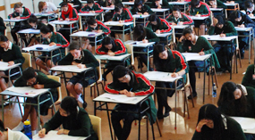
External Examination Dates.
Examinations run from November 5 – November 29 2024.

Slide 21
Attendance requirements.
You are expected to attend all classes at all times.
Legitimate absence for illness or other reasons must be supported by a note.
Absence will be taken into account when considering a student’s right for re-assessment.
Illegitimate absence will mean a student will gain no grade for that assessment.

Slide 22
Authenticity
Teachers will need to be sure the work students produce is their own.
There are many ways in which they will do this.
Work handed in that is not the students own will receive a not achieved grade. Beware the use of AI.

Slide 23
Reporting
Each year the school will issue two reports in Term 1 and Term 3.
Senior Conferencing Meetings with you and your
parents in Terms 1, 2, and 3
Students can also get an update of progress during the year through the KAMAR Portal. Results start going up there from April onwards.

Slide 24
NCEA Results
Mid - Late January 2025 you will receive an Interim Results Notice (if you request it online) showing all results of internal and external standards by subject. You can simply view this online as well with your NZQA login.
In April 2025 you will receive your Record Of Learning and your NCEA Level 1 if you have achieved it. You need to request this online.
You will also be able to access your results on the NZQA site at the end of the year.

Slide 25
NQF Results Notification Using your Student Login you can access a lot of information about your progress - Demonstration
Guide to online results » NZQA

Slide 26
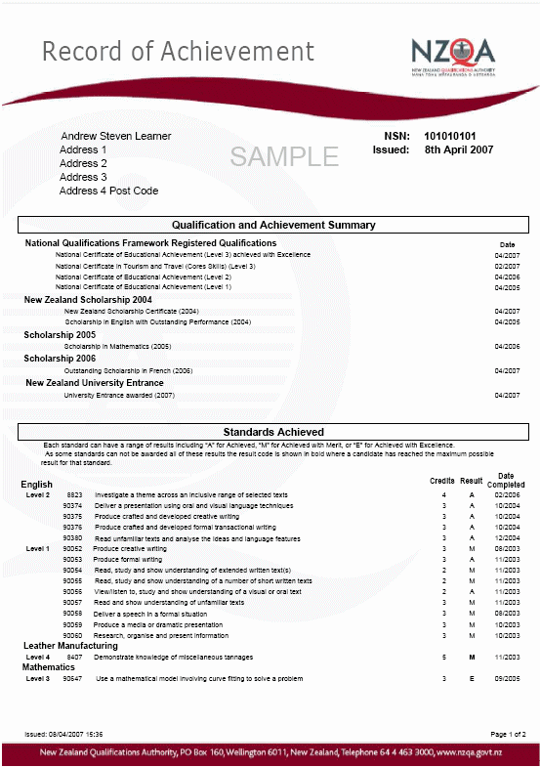
Record of Achievement
Shows achievements
Issued in May to all Yr 13
Leavers; others on request
Request via personal logon
to NZQA website;
or 04 463 3000

Slide 27
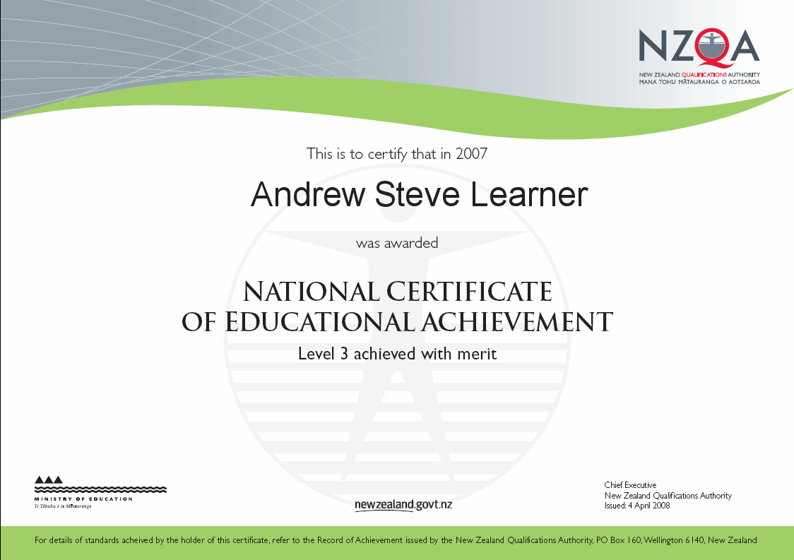
The Certificate

Slide 28
To Be Successful You Need:
To be very organised.
Have good attendance.
Have some career goals. Research this now.
Keep a diary/planner of assessment dates.
Take ownership of your own learning.
Make sure you understand rules and procedures to follow.
Ask if not sure – Teachers, Deans, NCEA Coordinator – Mr Beagley

Slide 29
NCEA: Tips for Parents
Ask your child how NCEA works - most
students understand it well.
Provide support (e.g. time, space, homework help) to help your child study - remember they will be assessed throughout the year, not just in final examinations.
When helping your child choose subjects, encourage them to take a broad range at level 1, but to start thinking about what areas they should focus on for future study or career at levels 2 and 3.

Slide 30
Use of Own Laptop
With the move to increasing amounts of online assessment we recommend all students have their own device. Why?
Literacy and Numeracy assessments are now online
Teachers set up class Teams where access to resources, activities and information can be found.
Increasing numbers of external assessments are now digital.
Regular use of a personal device makes learning and assessment more streamline.
A good way for students to organise themselves.
Study resources, KAMAR Portal, NZQA site are easy to access.

Slide 31
If they tell you, "It's okay, I only need to get Achieved", remind them that higher grades may be the difference between them or someone else getting the job they want, or getting into the tertiary course of their choice.
Ask your child’s teachers for guidance on how they are progressing.

Slide 32
Special Assessment Conditions
Special Assessment Conditions are available to meet a range of physical, emotional, sensory, medical, and learning needs. They provide flexibility in the ways learners can access and demonstrate their learning. They do not make assessments easier or impact their validity.
Special Assessment Conditions apply to both internal and external assessments towards NCEA and New Zealand Scholarship. They can include:
the use of a reader or writer assistant
rest breaks
access to quiet spaces
Braille or enlarged papers.
Applications for Special Assessment Conditions are made by schools to NZQA for students. Contact Nic Welch for assistance.

Slide 33
Also see the information for school students and parents section of the NZQA website. (www.nzqa.govt.nz)
For more advice see: https://parents.education.govt.nz/ (Ministry of Education's parents section, helping parents get more involved in their children's learning).

