Slide 1
Study Skills & NCEA

Slide 2
Why is Being Organised Important
Reduces stress
Better grades
Sleep better (because we all know we love sleep)
Being on time
Feel more confident for exams
Parents won't bug you as much
No last-minute confusions

Slide 3
How to be Organised and Use Your Time Wisely
Bring the correct equipment to classes
Make a timetable/putting time aside to study
Don’t procrastinate
Don’t leave everything to the last minute
Have a balance life to work
If you find your becoming stressed get some help
Time management

Slide 4
Using Tutorials
Lunch time tutorials
Asking teachers for tutorials on material you do not understand yet or for revision
Teachers know the assessment schedules, so this is the best way to prepare
Online tutorials

Slide 5
Exam Prep
Video tutorials
Copy notes
Keep practice exams
Use past exam papers
Practice reading essays aloud
Use your class resources
Look for study guides and extra resources

Slide 6
Managing your study time for exams
Spend time studying no matter how confident you feel
Use a timer
Put your phone on the other side of the room or give it to your parents
Have breaks to help clear your head
Don’t push yourself too hard
Look for study skills that suit you

Slide 7
Find your Study Technique
Few of the essential ones are,
Pomodoro technique (25 mins focus: 5 mins break)
Flashcards
Feynmann method (simplifying the idea and explaining in childish terms)
Mind mapping (brainstorming and connecting)

Slide 8
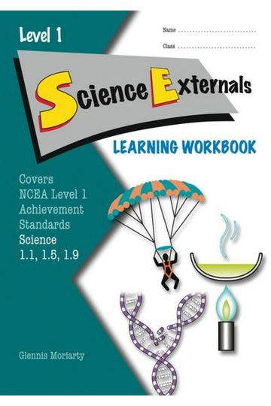
Useful websites and resources
Study It
Study Time – Website and YouTube channel
No Brain Too Small
Revision Scipads
Study Guidebooks
D & D study books
Quizlet
Flashcards app on phone
Ask your teachers for more useful resources!

Slide 9
Before the exams
Have a good sleep the night before
Eat something before the exam
Have a double check of your notes before you go into the exam
Plan what order you want to do your papers in
Have a positive attitude about your exam

Slide 10
Tips for in the exams
Stay calm
Look through all the questions first
Read the question fully and look for key words or definitions the question may be looking for
Show your working
Keep an eye on the time and don’t spend too long on one question
If you’re struggling, move on and come back later
Give every question a go (you can still be points for correct ideas but a wrong answer)
Use your planning space for essay

Slide 11
Managing Academic Stress
Don’t put too much on your plate
Don’t stress about getting perfect grades
Talk to a trusted adult or Mr Weston (Guidance Councilor)
Take a break and do something you find relaxing
Get enough sleep/take a short nap

Slide 12
Keeping Track of Your Credits

Slide 13
Parents do’s and don’ts
Sorry if they are a bit harsh

Slide 14
Parents Do’s - Supporting your child
Make sure they have breaks during study
Listen to you child and if they are stressed try help them
Make sure they are sleeping enough and eating well
Create a good study environment
If your child is really stressed, talk to them or get a professional (guidance councillor)
Talk to teachers, other parents and/or find resources online to find other ways to help your child
Be proud of your child

Slide 15
Parents Do’s - Helping academically
Prompt them with questions when they are stuck
Help explain definitions or questions they may not get
Find resources your child can use
If your child has dyslexia or other learning disabilities, help them write their internals but don’t do it form them
Help you child establish a study timetable
Help them find a revision style that works for them
Print out past exam papers or resources they may ask for
Get some book resources if they ask or need them
Contact teachers if you child needs extra help and doesn’t feel comfortable doing it themselves

Slide 16
Parents Don’ts
Don’t do your child's work for them (That’s Cheating!!!)
Don’t completely cut them off from their friends or social life during exams
Don’t put too much pressure on them and set really high standards
Don’t be overbearing – constantly ask what is going on and how they are
Don’t take them on holiday for ages then expect them to be magically able to catch up
Don’t give them huge jobs or go away for study leave and exams
Don’t pressure your child to go to other commitments when they are under academic stress
Don’t assume your children will be good in and/or enjoy the same subjects as you did
Don’t undermine your child's stress

